Slide 1



SQL INDIVIDUAL ASSIGNMENT
CASE OF THE LOOK ECOMMERCE
by
Alfian Panuntas

Slide 2
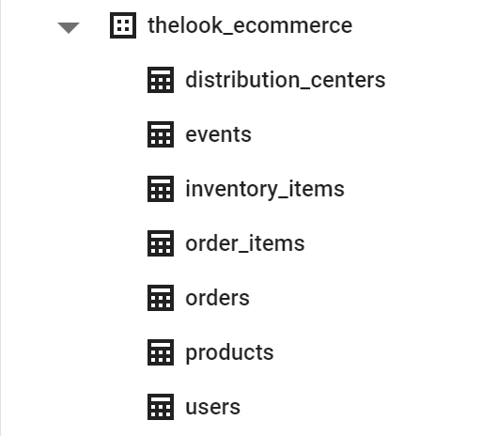
DATA OVERVIEW
THE LOOK ECOMMERCE
The Look is a fictitious eCommerce clothing site developed by the Looker team. The dataset contains information about customers, products, orders, logistics, web events and digital marketing campaigns. The contents of this dataset are synthetic, and are provided to industry practitioners for the purpose of product discovery, testing, and evaluation.
This data sourced from BigQuery Public Dataset. Click
here to see detail dataset.

Slide 3
INTERMEDIATE
ASSIGNMENT
QUESTION:
Find Top 10 customers with the highest average price per order.
Create a query to get the total users who completed the order and total orders per month (time frame Jan 2019 - Dec 2022).
Create a query to get average order value and total number of unique users, grouped by month (time frame Jan 2019 – Dec 2022).
Find the first and last name of users from the youngest and oldest age of each gender (time frame Jan 2019 - Dec 2022).
Get the top 5 most profitable product and its profit detail breakdown by month.
Create a query to get Month to Date of total revenue in each product categories of past 3 months (current date 30 Dec 2022), breakdown by date.
Find monthly growth of TPO (# of completed orders) and TPV (# of revenue) in percentage breakdown by product categories and analyze the monthly growth to gain insight (time frame Jan 2019 - Dec 2022). Ordered by time descendingly.
Create monthly retention cohorts (based upon the date that a user purchased a product) and then how many of them (%) coming back for the following month in 2019 - 2022 and gain the insight.

Slide 4
QUESTION 1 - SQL SYNTAX
Click Here to Open Query Link
#QUESTION-1 Top 10 customers with the highest average price per order (time frame Jan 2019 - Dec 2022)
SELECT u.id as user_id, u.first_name, u.last_name, avg(oi.sale_price) as avg_sale_price
FROM `bigquery-public-data.thelook_ecommerce.users` as u
JOIN `bigquery-public-data.thelook_ecommerce.order_items` as oi
ON u.id = oi.user_id
WHERE DATE(oi.created_at) BETWEEN '2022-01-01' AND '2022-12-30'
GROUP BY 1,2,3
ORDER BY avg_sale_price DESC
LIMIT 10 ;

Slide 5
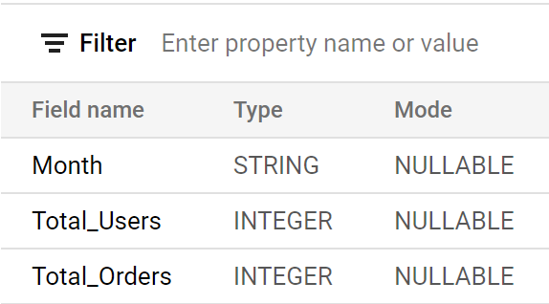
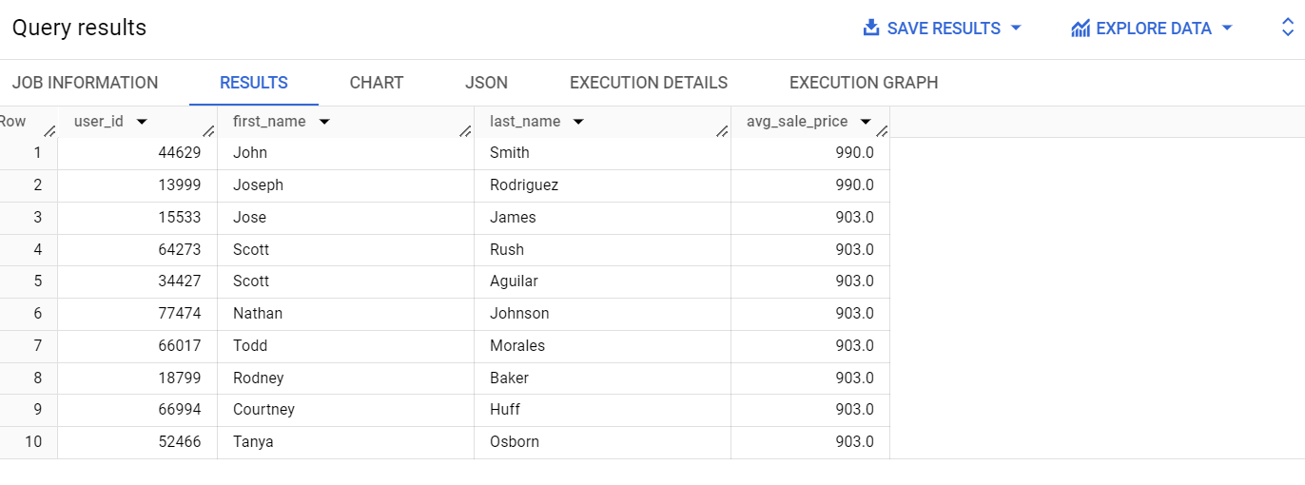
QUESTION 1
Get Top 10 customers with the highest average price per order.
TABLE SCHEMA
TABLE RESULT

Slide 6
QUESTION 2 - SQL SYNTAX
Click Here to Open Query Link
#QUESTION-2 Create a query to get the total users who completed the order and total orders per month (time frame Jan 2019 - Apr 2022)
SELECT
FORMAT_DATE('%b-%Y', created_at) AS Month,
COUNT(DISTINCT user_id) AS Total_Users,
COUNT(order_id) AS Total_Orders
FROM `bigquery-public-data.thelook_ecommerce.orders`
WHERE status = 'Complete'
AND delivered_at IS NOT NULL
AND created_at BETWEEN '2019-01-01' AND '2022-12-30'
GROUP BY Month
ORDER BY PARSE_DATE('%b-%Y', Month);

Slide 7
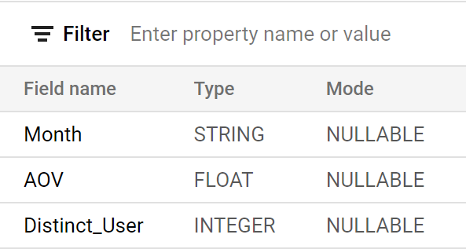
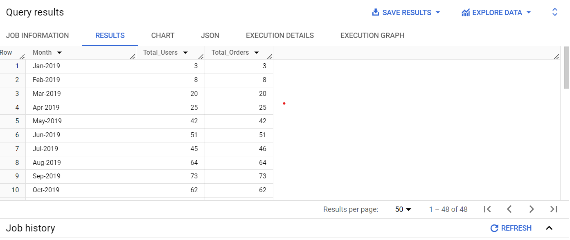
QUESTION 2
Create a query to get the total users who completed the order and total orders per month (time frame Jan 2019 - Dec 2022).
TABLE RESULT
TABLE SCHEMA

Slide 8
QUESTION 3 - SQL SYNTAX
Click Here to Open Query Link
#QUESTION-3 Create a query to get average order value and total number of unique users, grouped by month (time frame Jan 2019 - Dec 2022)
SELECT
FORMAT_DATETIME('%b-%Y', orders.created_at) AS Month,
ROUND(SUM(order_items.sale_price)/COUNT(orders.order_id),2) AS AOV,
COUNT (DISTINCT orders.user_id) Distinct_User
FROM `bigquery-public-data.thelook_ecommerce.orders` orders
INNER JOIN `bigquery-public-data.thelook_ecommerce.order_items` order_items
ON orders.order_id = order_items.order_id
WHERE orders.status = 'Complete'
AND orders.delivered_at IS NOT NULL
AND orders.created_at BETWEEN '2019-01-01' AND '2022-12-30'
GROUP BY Month
ORDER BY PARSE_DATE('%b-%Y', Month);

Slide 9
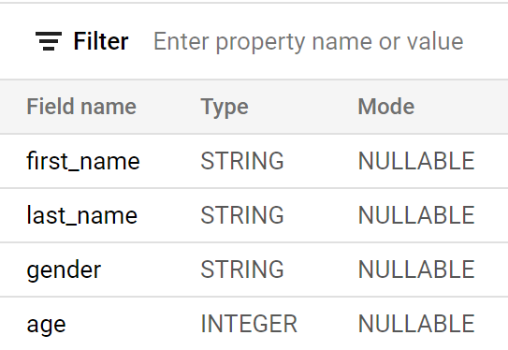
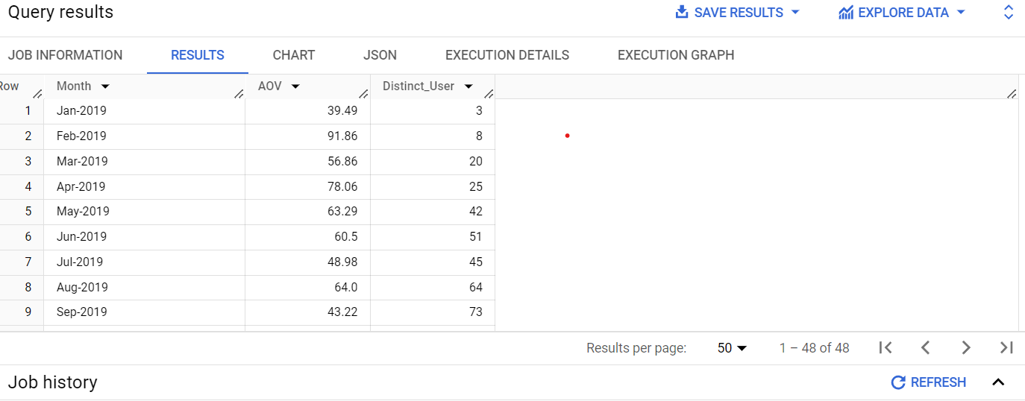
QUESTION 3
Create a query to get average order value and total number of unique users, grouped by month (time frame Jan 2019 - Dec 2022)
TABLE RESULT
TABLE SCHEMA

Slide 10
QUESTION 4 - SQL SYNTAX
Click Here to Open Query Link
#QUESTION-4 Find the first and last name of users from the youngest and oldest age of each gender (time frame Dec 2022 ).
WITH youngest_user AS
(SELECT first_name, last_name, gender, age,
FROM `bigquery-public-data.thelook_ecommerce.users`
WHERE created_at BETWEEN '2022-12-01' AND '2022-12-31'
AND age =
(SELECT MIN(age),
FROM `bigquery-public-data.thelook_ecommerce.users`)),
oldest_user AS
(SELECT first_name, last_name, gender, age
FROM `bigquery-public-data.thelook_ecommerce.users`
WHERE created_at BETWEEN '2022-12-01' AND '2022-12-31'
AND age =
(SELECT MAX(age),
FROM `bigquery-public-data.thelook_ecommerce.users`))
SELECT *
FROM youngest_user
UNION DISTINCT
SELECT *
FROM oldest_user
ORDER BY gender;

Slide 11
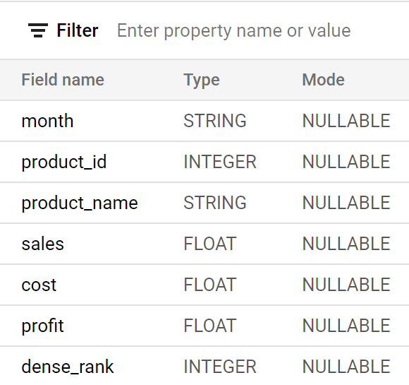
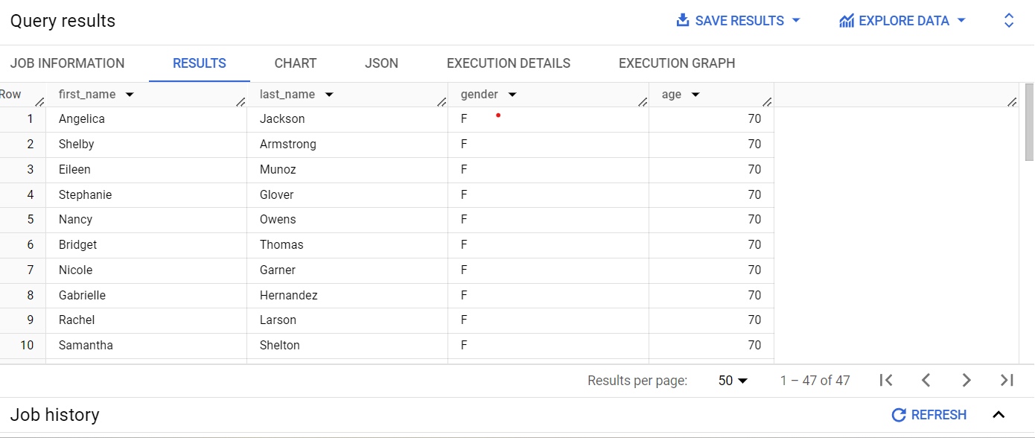
QUESTION 4
Find the first and last name of users from the youngest and oldest age of each gender (time frame Dec 2022).
TABLE SCHEMA
TABLE RESULT
Youngest age of user is 12 years old and the Oldest age is 70 years old.
Data will shown ordered by gender: Female (F) and Male (M).

Slide 12
QUESTION 5 - SQL SYNTAX
Click Here to Open Query Link
WITH profit_calculation AS
(SELECT
FORMAT_DATE('%b-%Y', order_items.created_at) Month,
inventory_items.product_id product_id,
inventory_items.product_name,
ROUND(SUM(inventory_items.product_retail_price),2) Sales,
ROUND(SUM(inventory_items.cost),2) cost,
ROUND(SUM((inventory_items.product_retail_price-inventory_items.cost)),2) Profit
FROM `bigquery-public-data.thelook_ecommerce.order_items` order_items
LEFT JOIN
`bigquery-public-data.thelook_ecommerce.inventory_items` inventory_items
ON order_items.inventory_item_id = inventory_items.id
WHERE order_items.created_at BETWEEN '2019-01-01' AND '2022-12-31'
GROUP BY
month, product_id, product_name
ORDER BY
PARSE_DATE('%b-%Y', Month), Profit ASC)
SELECT *
FROM
(SELECT*,DENSE_RANK()OVER(PARTITION BY profit_calculation.Month ORDER BY profit_calculation.Profit DESC) AS dense_rank
FROM profit_calculation
ORDER BY PARSE_DATE('%b-%Y',profit_calculation.month))
WHERE dense_rank <= 5;

Slide 13
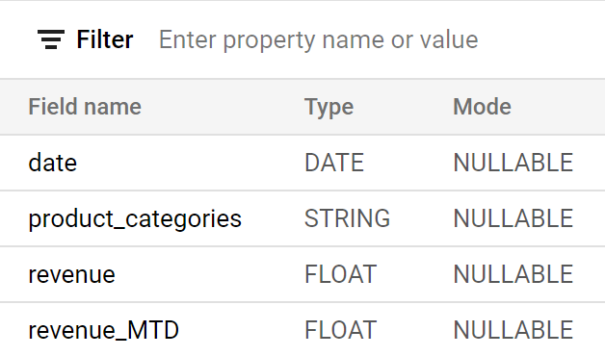
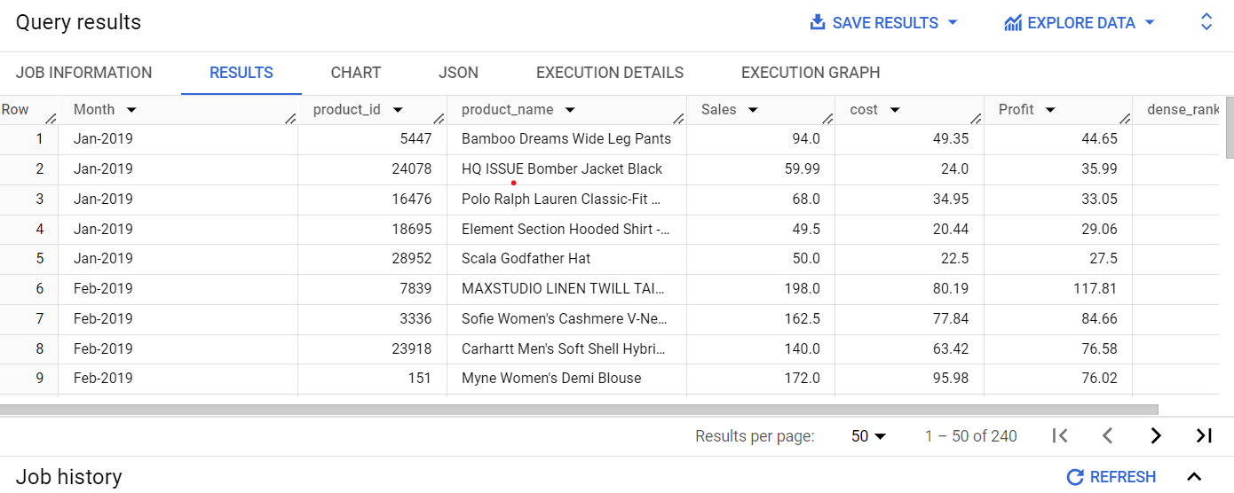
QUESTION 5
Get the top 5 most profitable product and its profit detail breakdown by month
TABLE SCHEMA
TABLE RESULT
Data will shown top 5 most profitable product for each month.

Slide 14
QUESTION 6- SQL SYNTAX
#QUESTION-6 Create a query to get Month to Date of total revenue in each product categories of past 3 months (current date 30 DEC 2022), breakdown by date.
WITH revenue_calculation AS
(SELECT
DATE(order_items.created_at) as date,
inventory_items.product_category as product_categories,
ROUND(SUM(order_items.sale_price),2) as revenue
FROM `bigquery-public-data.thelook_ecommerce.order_items` order_items
INNER JOIN
`bigquery-public-data.thelook_ecommerce.inventory_items` inventory_items
ON order_items.inventory_item_id = inventory_items.id
WHERE DATE(order_items.created_at) BETWEEN '2022-10-01' AND '2022-12-31'
AND order_items.status = 'Complete'
GROUP BY 1,2
ORDER BY 1,2)
SELECT *,
ROUND(SUM(revenue_calculation.revenue)OVER(PARTITION BY revenue_calculation.product_categories ORDER BY revenue_calculation.date),2) as revenue_MTD
FROM revenue_calculation
WHERE revenue_calculation.date BETWEEN '2022-12-01' AND '2022-12-31'
UNION ALL
SELECT *,
ROUND(SUM(revenue_calculation.revenue)OVER(PARTITION BY revenue_calculation.product_categories ORDER BY revenue_calculation.date),2) as revenue_MTD
FROM revenue_calculation
WHERE revenue_calculation.date BETWEEN '2022-11-01' AND '2022-11-30'
UNION ALL
SELECT
*,
ROUND(SUM(revenue_calculation.revenue)OVER(PARTITION BY revenue_calculation.product_categories ORDER BY revenue_calculation.date),2) as revenue_MTD
FROM revenue_calculation
WHERE revenue_calculation.date BETWEEN '2022-10-01' AND '2022-10-31';

Slide 15
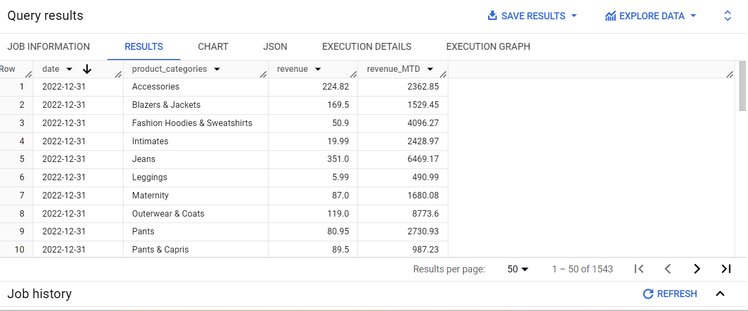
Create a query to get Month to Date of total revenue in each product categories of past 3 months (current date 30 Dec 2022), breakdown by date j
QUESTION 6
Data will shown Month to Date revenue based on product category for 3 months (Oct, Nov, Dec 2022) which each month only containing 31 days (1 - 31).

Slide 16
QUESTION 7- SQL SYNTAX
Click Here to Open Query Link
#QUESTION-7 Find monthly growth of TPO (# of completed orders) and TPV (# of revenue) in percentage breakdown by product categories and analyze the monthly growth to gain insight (time frame Jan 2019 - Dec 2022). Ordered by time descendingly.
WITH monthly_recap AS
(SELECT
DATE_TRUNC(DATE(order_items.created_at),month) AS date,
inventory_items.product_category AS product_categories,
COUNT(order_items.id) AS order_qty,
ROUND(SUM(order_items.sale_price),2) AS revenue
FROM `bigquery-public-data.thelook_ecommerce.order_items` order_items
INNER JOIN `bigquery-public-data.thelook_ecommerce.inventory_items` inventory_items
ON order_items.inventory_item_id = inventory_items.id
WHERE DATE(order_items.created_at) BETWEEN DATE(2019,01,01) AND DATE(2022,12,31)
AND order_items.status = 'Complete'
GROUP BY 1,2
ORDER BY 1 DESC,2),
growth AS(SELECT*,
LAG(order_qty)OVER(PARTITION BY product_categories ORDER BY date) previous_order_qty,
LAG(revenue)OVER(PARTITION BY product_categories ORDER BY date) previous_revenue,
FROM monthly_recap)
SELECT
date,
product_categories, order_qty AS TPO,revenue AS TPV,
CONCAT(COALESCE(ROUND((order_qty-previous_order_qty)/previous_order_qty*100),0), '%') order_growth_percentage,
CONCAT(COALESCE(ROUND((revenue-previous_revenue)/previous_revenue*100),0), '%') revenue_growth_percentage
FROM growth
ORDER BY product_categories, date DESC;

Slide 17
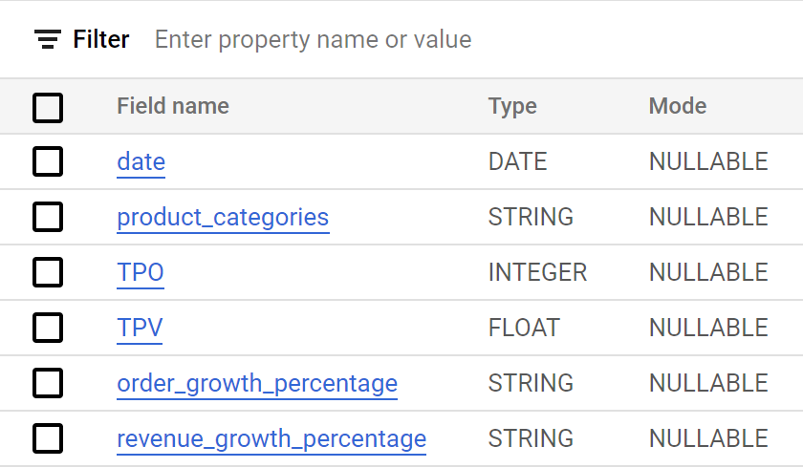
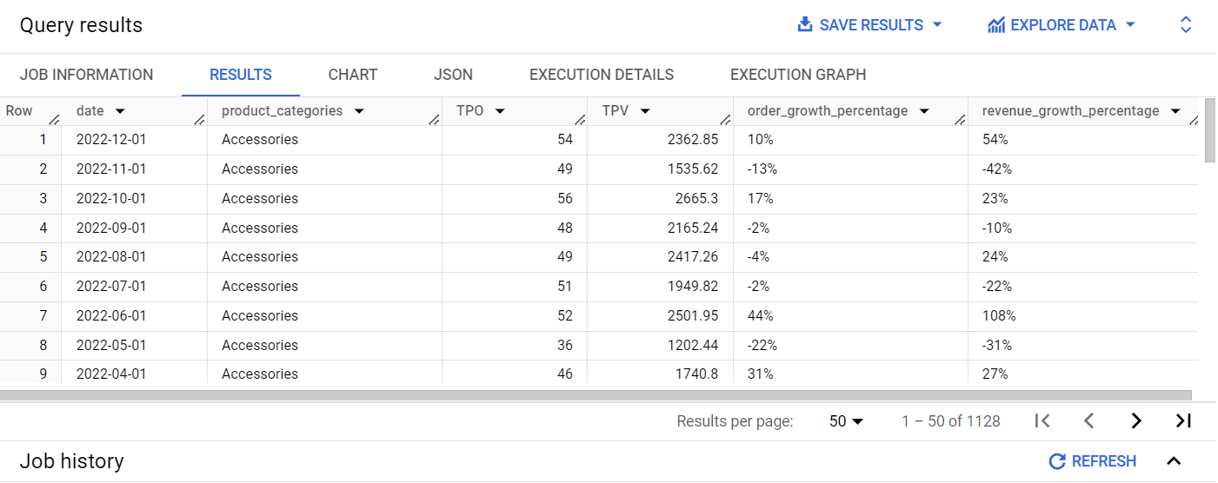
QUESTION 7
Find monthly growth of TPO (# of completed orders) and TPV (# of revenue) in percentage breakdown by product categories and analyze the monthly growth to gain insight (time frame Jan 2019 - Dec 2022). Ordered by time descendingly
TABLE SCHEMA
TABLE RESULT

Slide 18
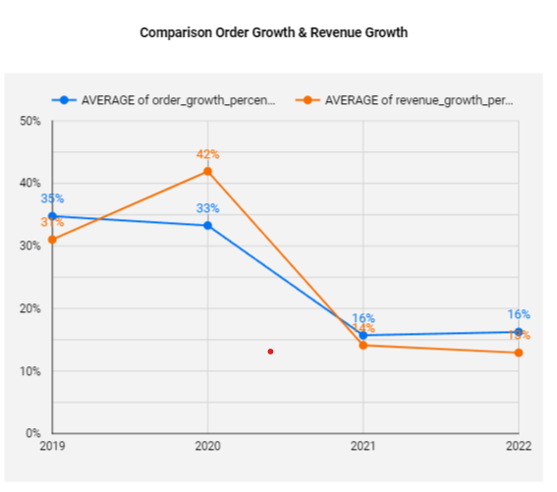
QUESTION 7- DATA ANALYSIS & INSIGHT
Average of Order Growth and Revenue Growth Declined Over The Year (2019 - 2022)
Based on chart it shown downtrend occurred on total order and revenue.
Significantly drop occurred on 2021, need to investigate further to find its caused factor.

Slide 19
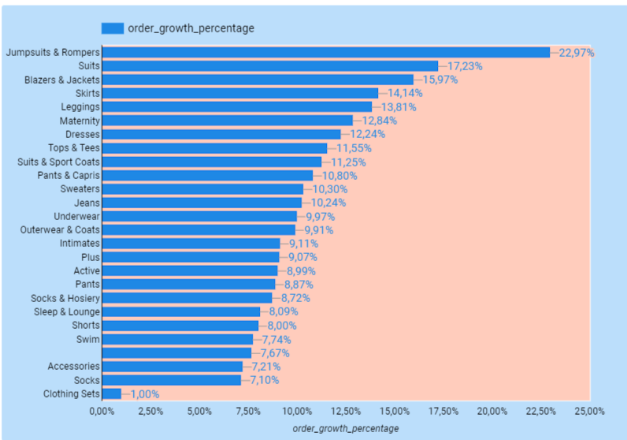
QUESTION 7 - DATA ANALYSIS & INSIGHT
From anyone
From anyone
Order Growth Based On Product Categories
In the green bracket shown top 3 product categories which have order growth > 15%.
In the red bracket shown product categories which have order growth < 5%.

Slide 20
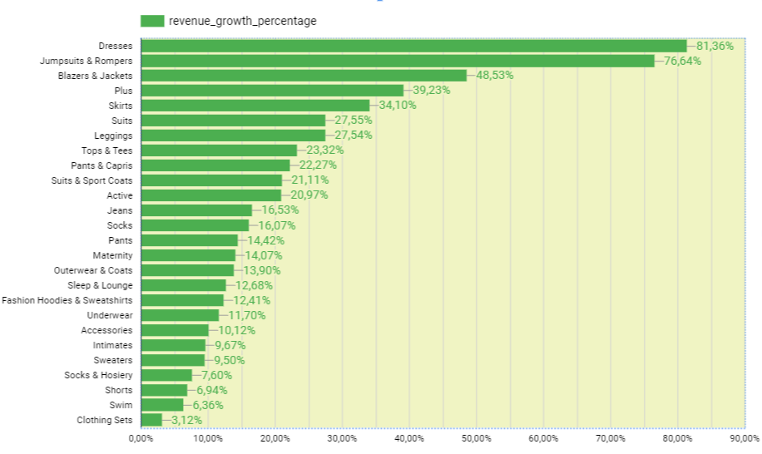
QUESTION 7 - DATA ANALYSIS & INSIGHT
Dresses Is The Most Significant Revenue Growth
Dresses Category become the most significant revenue growth (81,36%)
Jumpsuits & Rompers at the second place with 76,65%
The least 5 product category: Clothing Sets, Swim, Shots, Socks & Hosiery, Sweaters. Need to be evaluated.

Slide 21
THANK YOU

